Slide 1
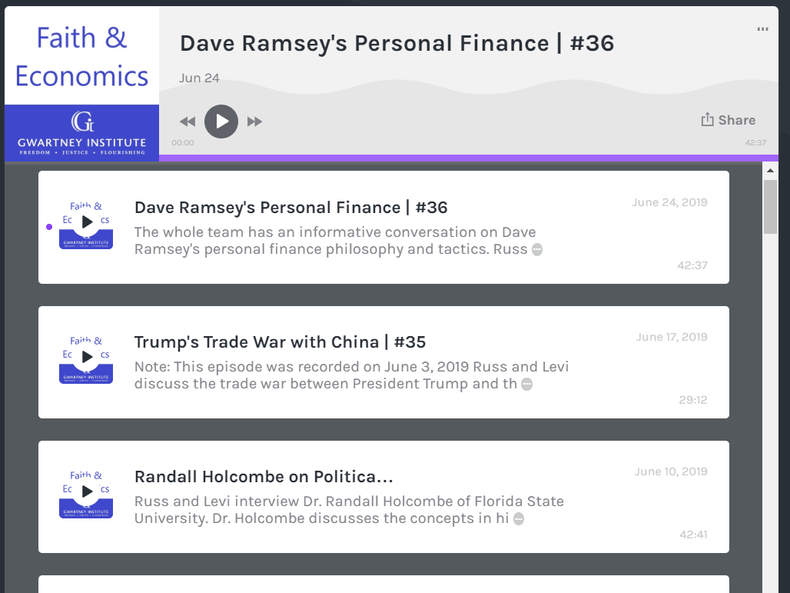









Check out our Podcast!
podcast.123povertysucks.org

Slide 2
What should I do today?
What should I do today?

Slide 3
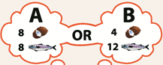
Tom’s Posibilities
4C = 4F therefore “1F costs 1C”

Slide 4
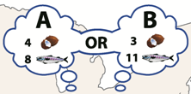
1C = 3F therefore “1F costs 1/3C”

Slide 5
Who should do what?
1C = 3F therefore “1F costs 1/3C”
4C = 4F therefore “1F costs 1C”
Jen is better for Fishing
Tom is better for Coconuts
4C = 4F therefore “1C costs 1F”
1C = 3F therefore “1C costs 3F”

Slide 6
Jen specializes in Fish
Tom specializes in Coconuts
Island Production with specialization
All other combinations for society without specialization are less than potential

Slide 7
How about 2 Fish per Coconut?
???

Slide 8
How about 2 Fish per Coconut?
We got a deal!

Slide 9
Two Winners!
Tom after trade
Jen after trade
Both better with trade

Slide 10
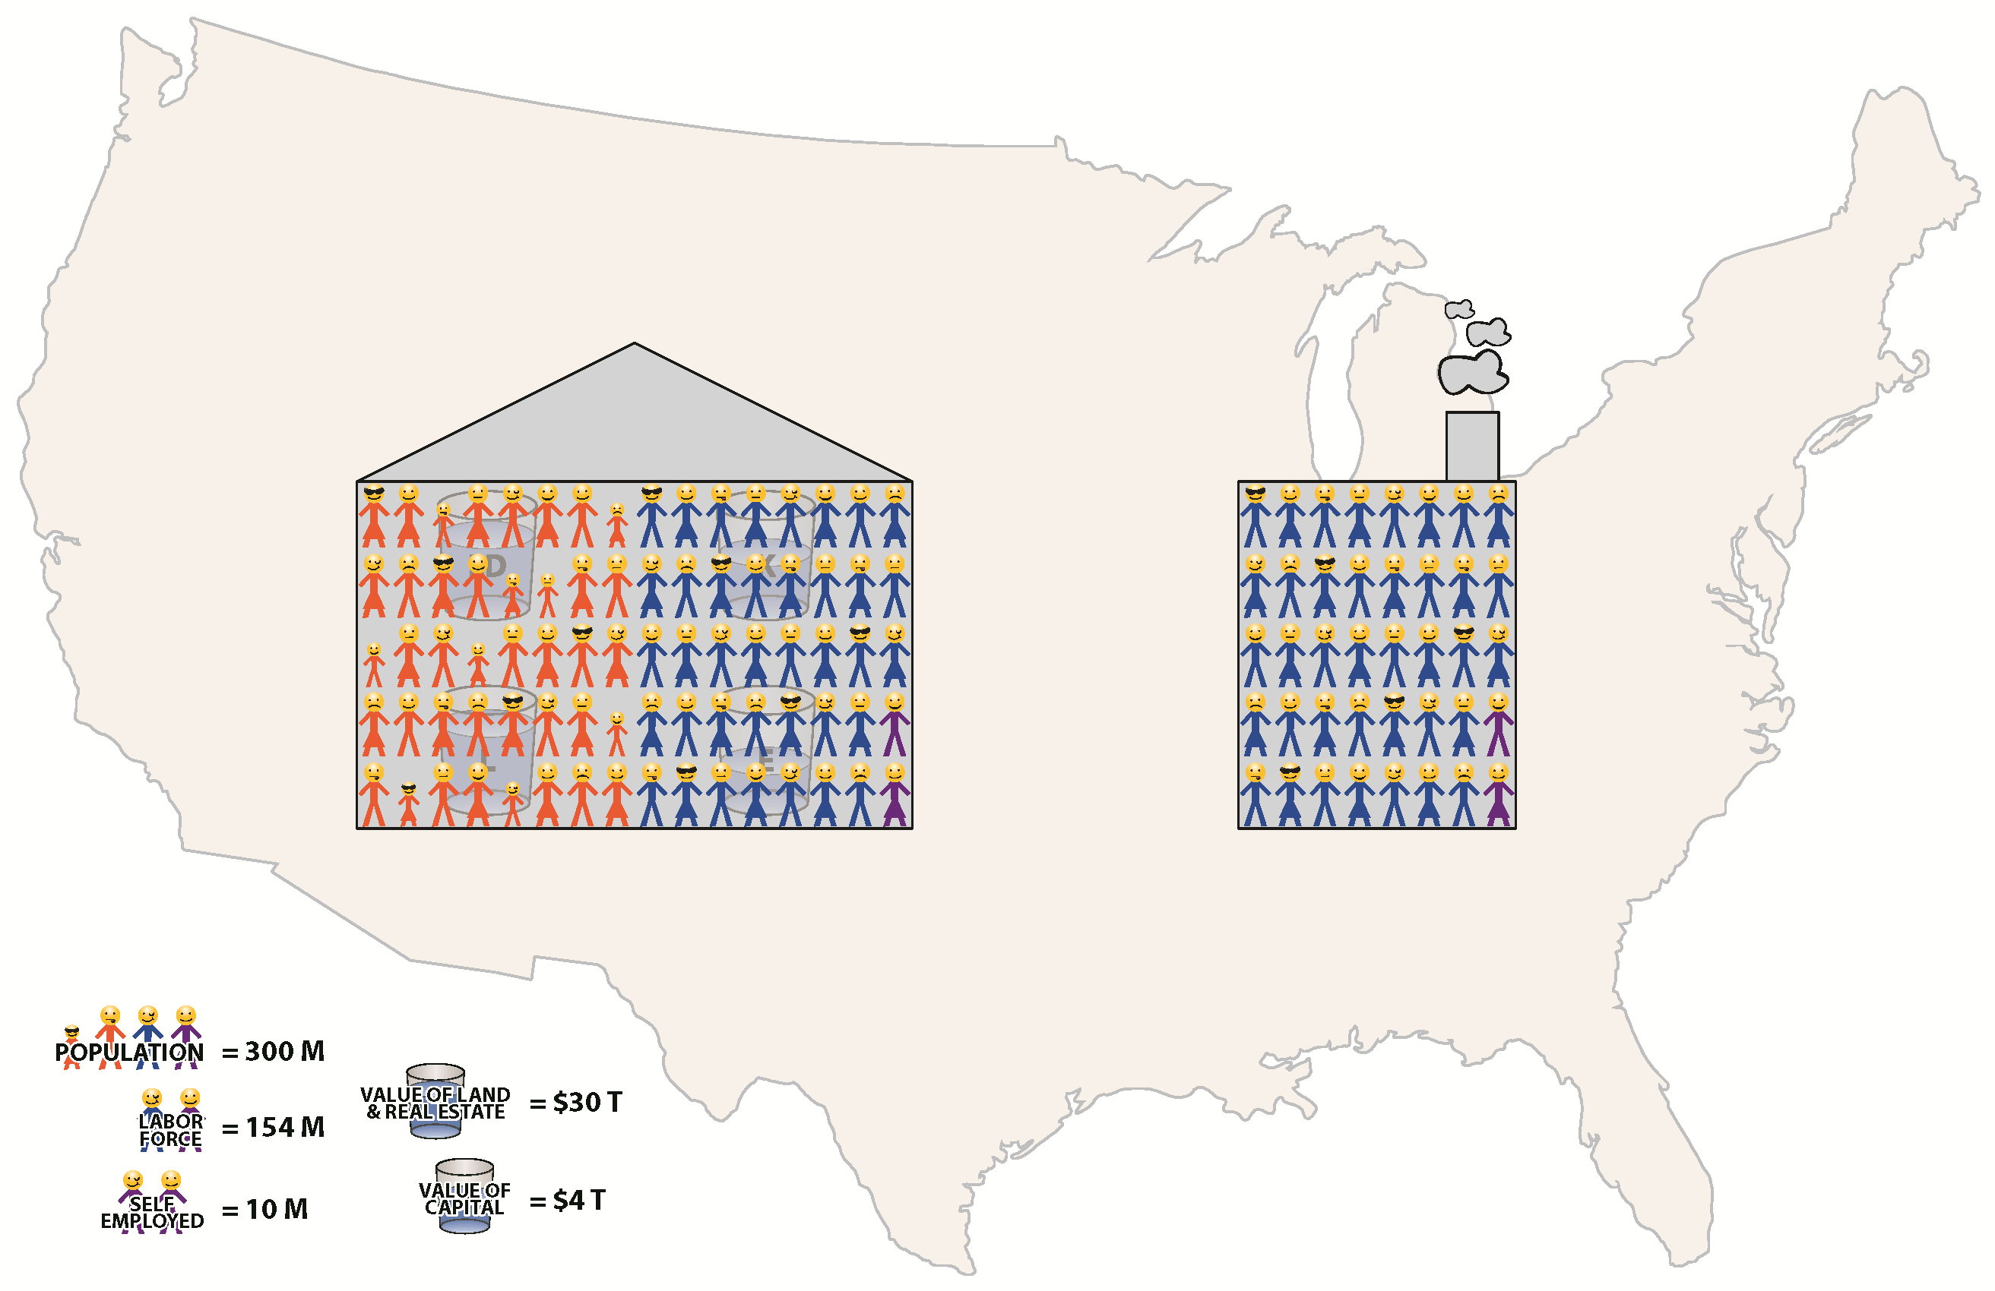
Specialization Today

Slide 11




Economic Freedom
of the World
Russ McCullough PhD
Wayne Angell Chair of Economics
Angell Snyder School of Business
Founder/Director, Gwartney Institute
Levi Russell PhD
Economic Education and Research
Angell Snyder School of Business
Associate Professor, Gwartney Institute
James Gwartney PhD
Eminent Scholar – The Gus A. Stavros Center for the Advancement of Economic Education and Free Enterprise

Slide 12
What is economic freedom?
Individuals have economic freedom when property they acquire without the use of force, fraud, or theft is protected from physical invasions by others and they are free to use, exchange, or give their property as long as their actions do not violate the identical rights of others.
In order to achieve a high economic freedom rating, a country must keep government spending and taxes low, provide access to sound money, protect property rights, and enforce contracts evenhandedly. It must also refrain from imposing trade barriers and regulations that undermine voluntary exchange

Slide 13
Methodology of EFW Index
Objectivity and transparency
162 countries
42 variables grouped into 5 areas
Time series: 1980-2016 for 102 countries
0-10 rating scale for components with 10 indicating more economic freedom
Gender adjustment – Gender Disparity Index (GDI) used to adjust Area 2 (Legal System)

Slide 14
The Five Areas of EFW Index
Size of Government
Legal System and Protection of Property Rights
Access to Sound Money
Freedom to Trade Internationally
Regulation of Capital, Labor, and Business

Slide 15
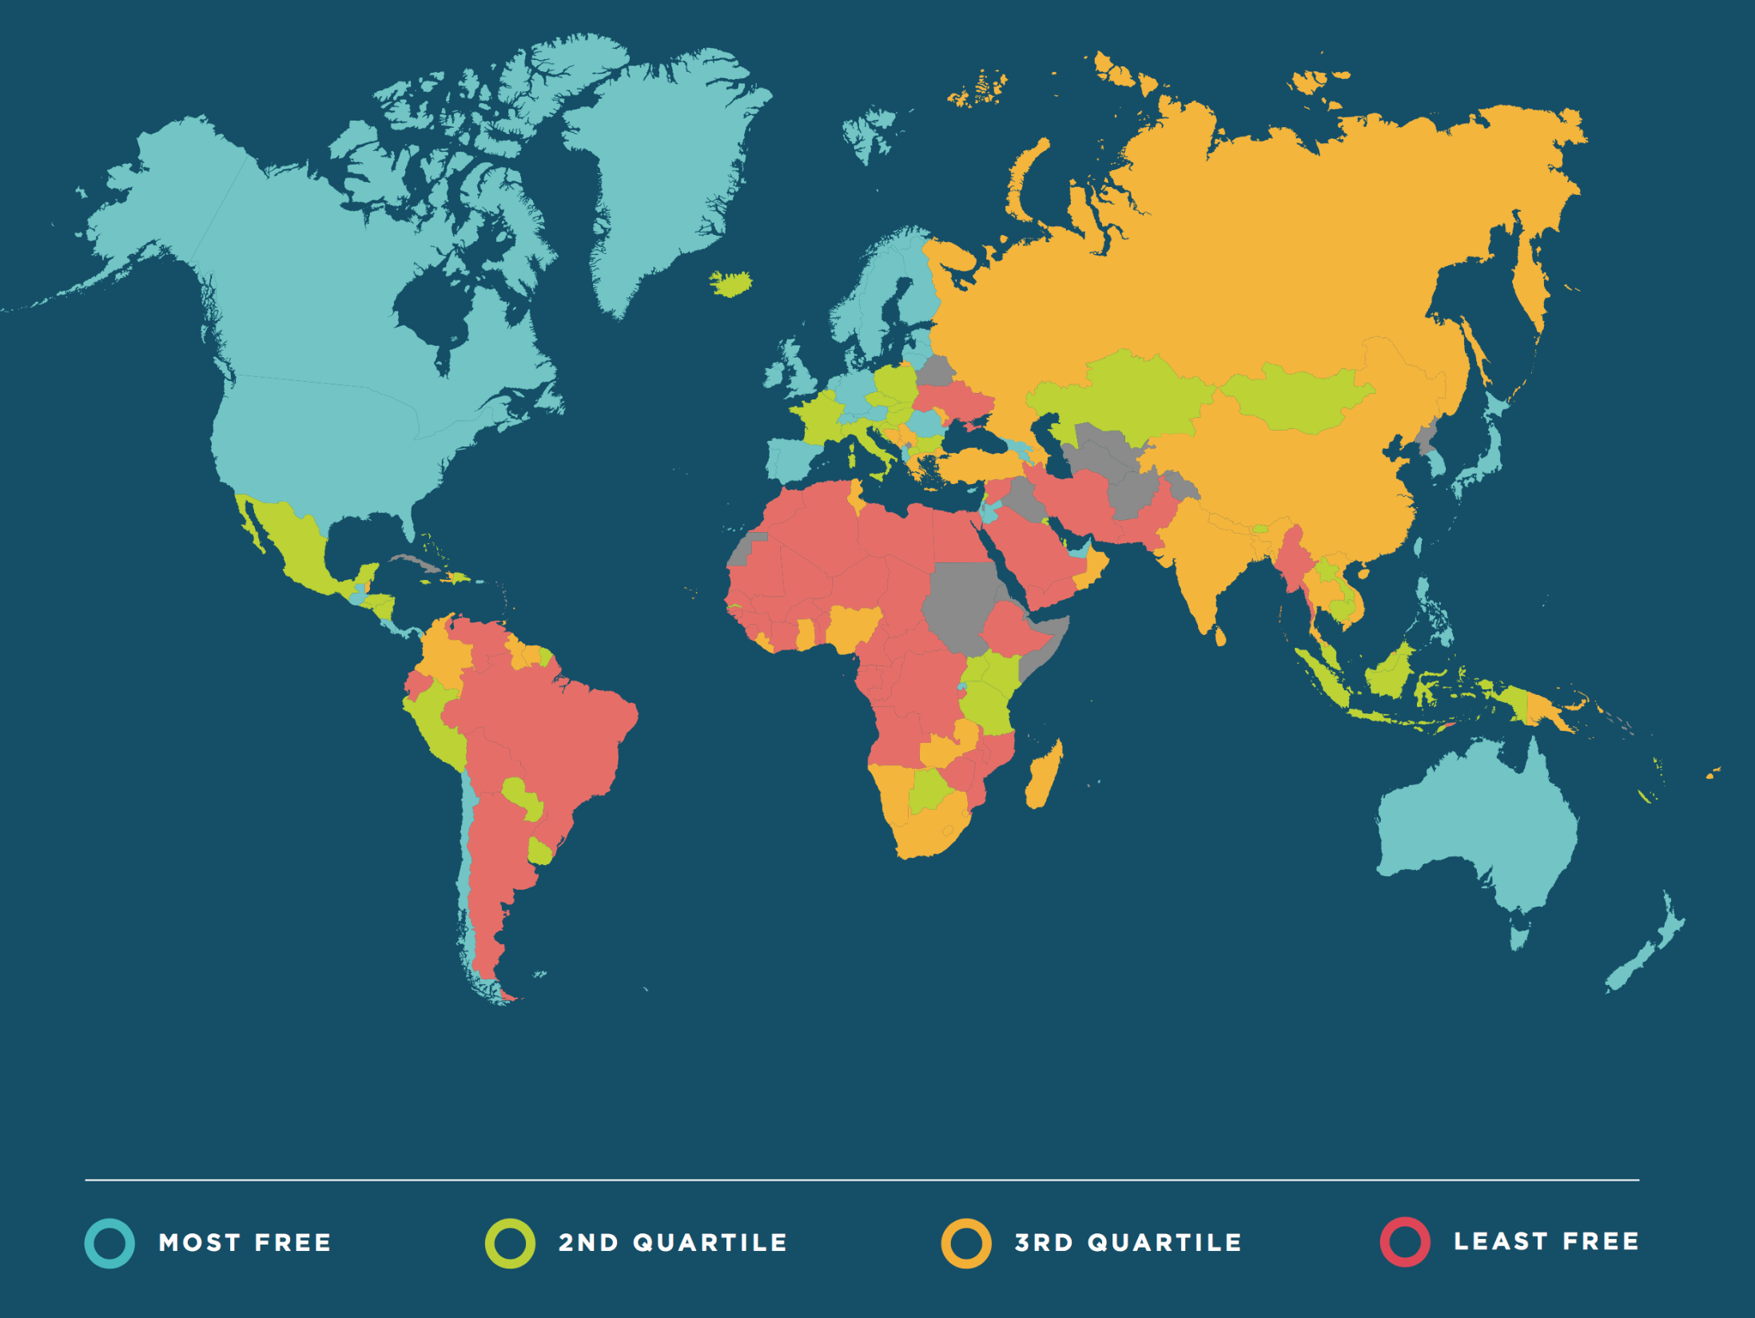

Slide 16
Economic Freedom Ratings, 2016
Top 10
Source: EFW 2018, Exhibit 1.2.

Slide 17
Economic Freedom Ratings, 2016
Select Nations
Source: EFW 2018, Exhibit 1.2.

Slide 18
Three Lessons from the EFW Project
Economic freedom has increased since 1980
Income gap between high-income and developing countries has narrowed (less Income Inequality)
Economic freedom matters. Numerous studies indicate that countries with more economic freedom have higher levels of investment, more rapid growth, and higher per capita GDP.

Slide 19
Three Lessons from the EFW Project
Economic freedom has increased since 1980

Slide 20
Three Lessons from the EFW Project
Income gap between high-income and developing countries has narrowed
Growth Rates of per capita GDP for Several Groups of Countries
(Periods 1995-2015 and 2005-2015)
Population Weighted Average Annual Growth Rate (percent)

Slide 21
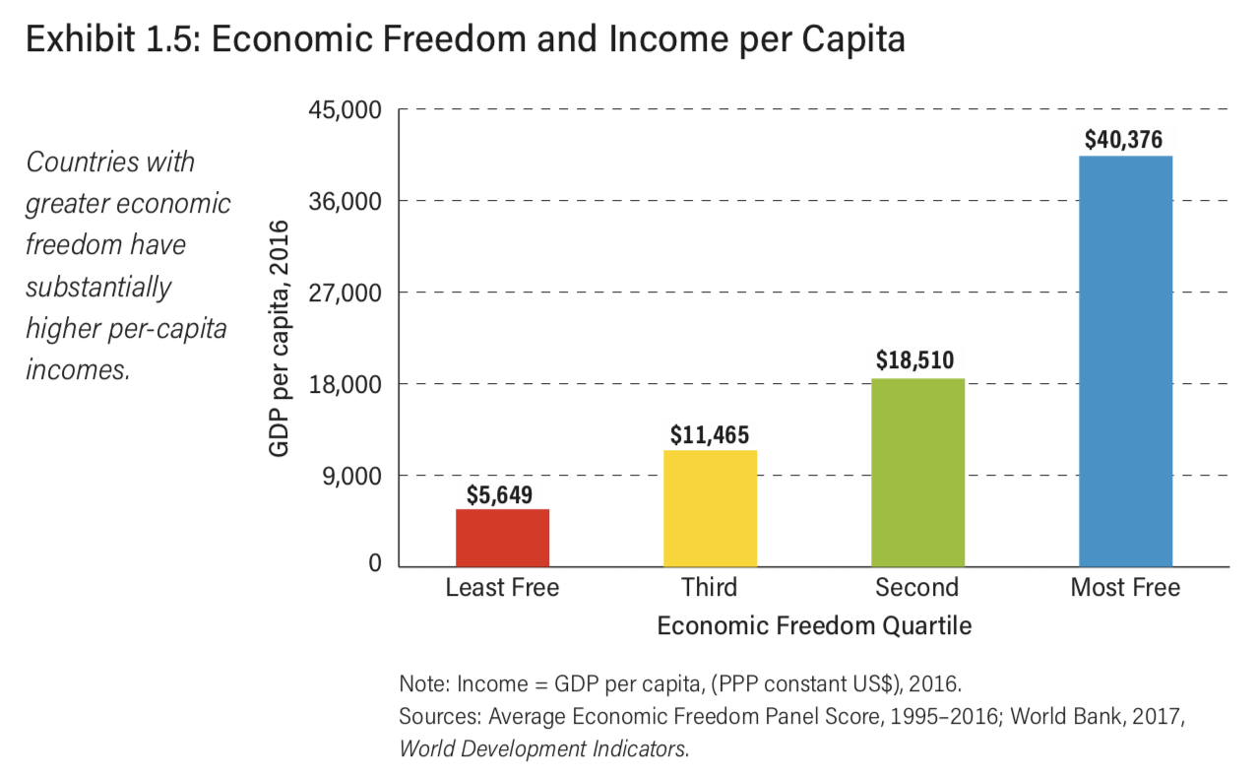
Three Lessons from the EFW Project
Economic freedom matters. Numerous studies indicate that countries with more economic freedom have higher levels of investment, more rapid growth, and higher per capita GDP.

Slide 22
Three Lessons from the EFW Project
Economic freedom matters. Numerous studies indicate that countries with more economic freedom have higher levels of investment, more rapid growth, and higher per capita GDP.

Slide 23
Three Lessons from the EFW Project
Economic freedom matters. Numerous studies indicate that countries with more economic freedom have higher levels of investment, more rapid growth, and higher per capita GDP.

Slide 24
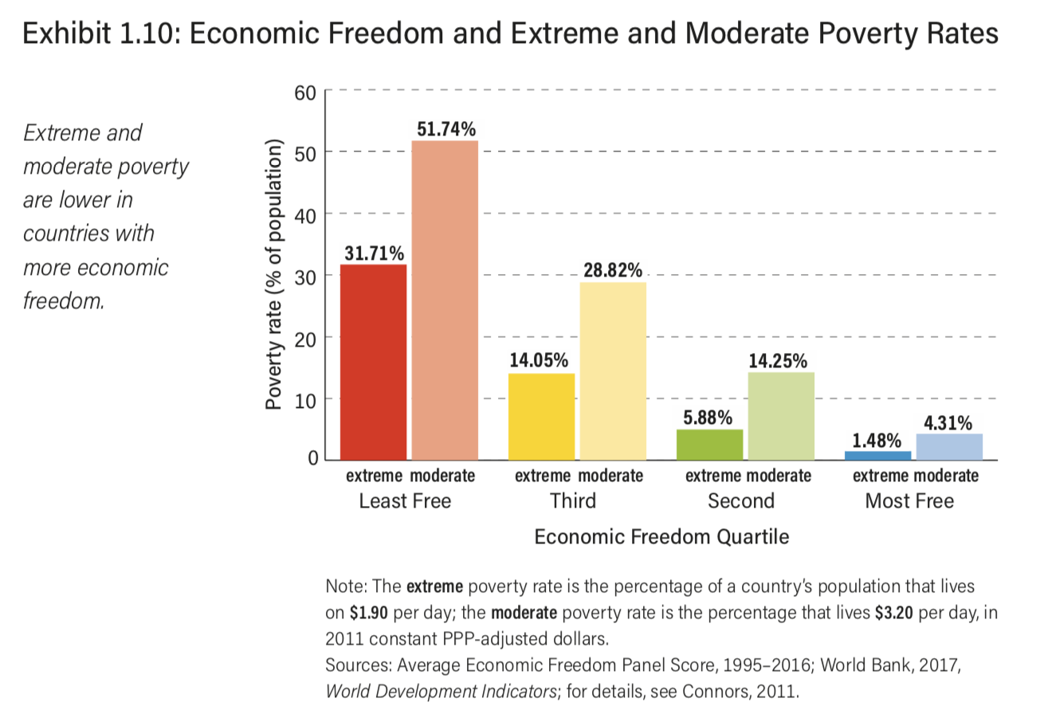
Three Lessons from the EFW Project

Slide 25
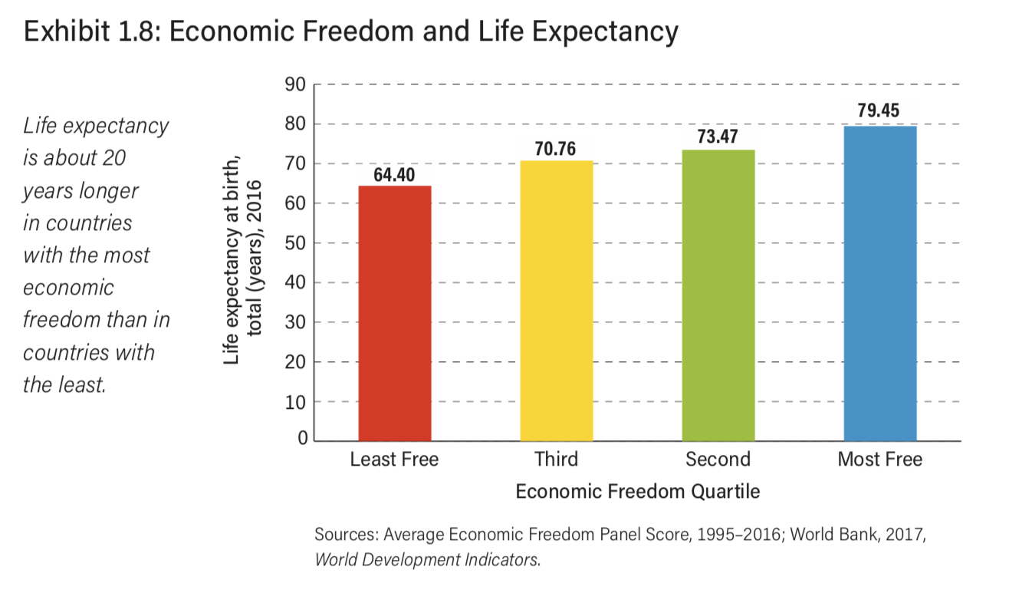
Three Lessons from the EFW Project
Economic freedom matters. Numerous studies indicate that countries with more economic freedom have higher levels of investment, more rapid growth, and higher per capita GDP.

Slide 26
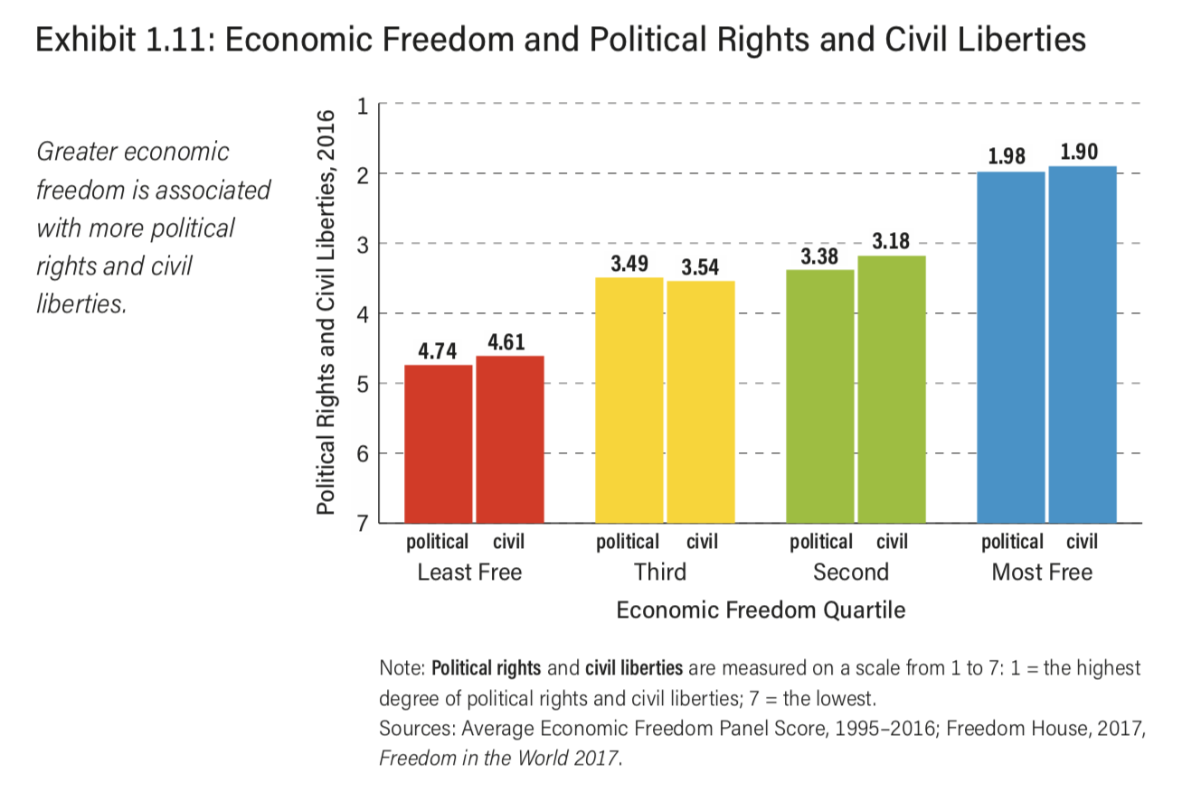
Three Lessons from the EFW Project

Slide 27
Three Lessons from the EFW Project

Slide 28
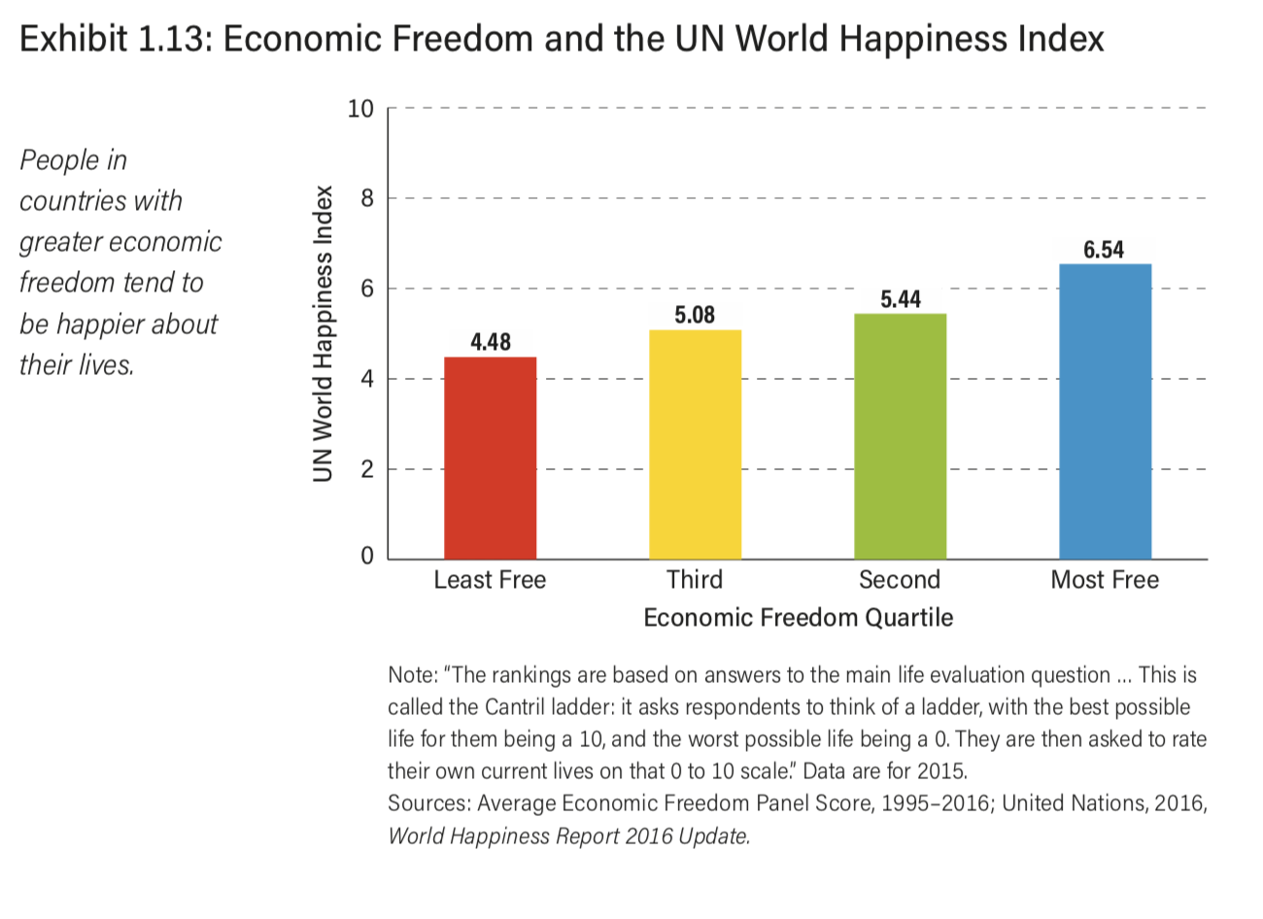
Three Lessons from the EFW Project

Slide 29
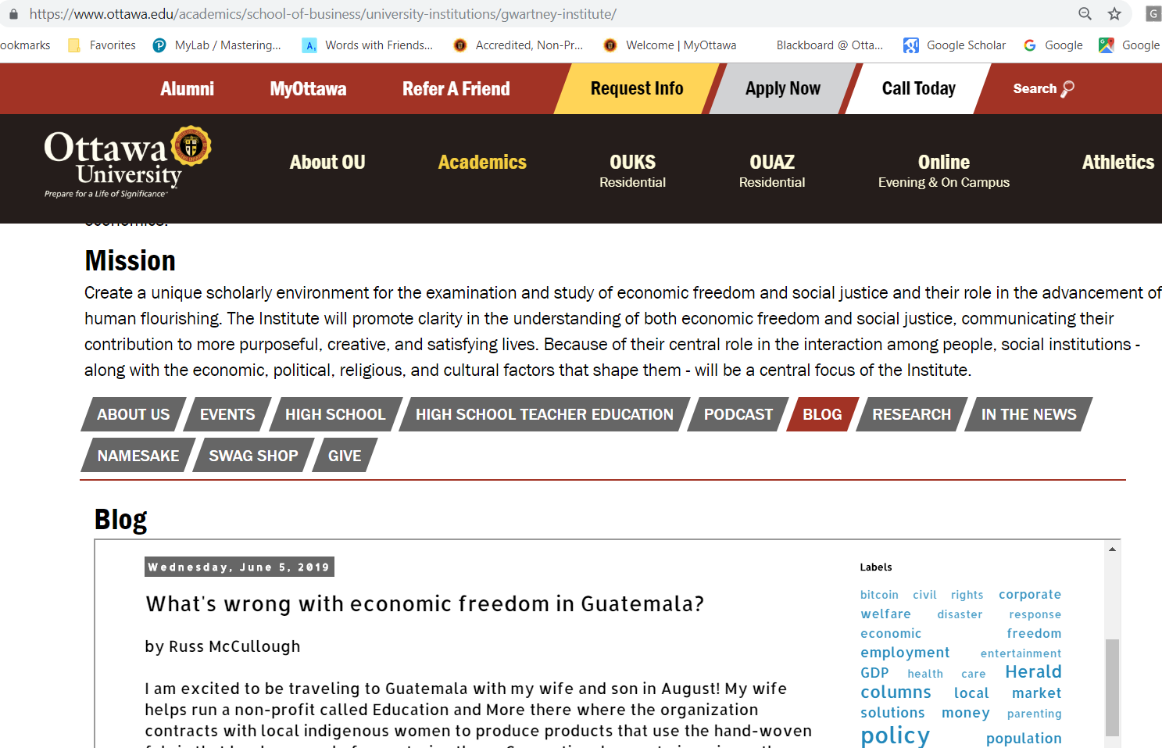
Guatemala ranked 23 of 162?

Slide 30
Overall Rank of 23 in the World

Slide 31
Overall score 7.64 (most free?)
#1
#29
#114
#110
#20

Slide 32
Smaller ‘Size of Government’ than all average quartiles
Good?
General government consumption spending as a percentage of total consumption.
General government transfers and subsidies as a share of GDP.

Slide 33
1A Government consumption
This component is measured as general government consumption spending as a percentage of total consumption.
1B Transfers and subsidies
This component is measured as general government transfers and subsidies as a share of GDP.

Slide 34

Overall score 7.64 (most free?)
#1
#29
#114
#110
#20

Slide 35
Property rights recommendations
Good

Slide 36
Low hanging fruit
Global Competitiveness Report question:
“To what extent does the incidence of crime and violence impose costs on businesses in your country? (1 = To a great extent; 7 = Not at all)”.
World Bank’s Doing Business estimates for the time and money required to collect a debt.
time cost (measured in number of calendar days required from the moment the lawsuit is filed until payment);
monetary cost of the case (measured as a percentage of the debt).
International Country Risk Guide Political Risk Component I for Law and Order:
“The ‘law’ sub-component assesses the strength and impartiality of the legal system, and the ‘order’ subcomponent assesses popular observance of the law”.
Global Competitiveness Report question: “The legal framework in your country for private businesses to settle disputes and challenge the legality of government actions and/or regulations is inefficient and subject to manipulation (= 1) or is efficient and follows a clear, neutral process (= 7)”.
Global Competitiveness Report question:
“To what extent can police services be relied upon to enforce law and order in your country? (1 = Cannot be relied upon at all; 7 = Can be completely relied upon)”.

Slide 37

Overall score 7.64 (most free?)
#1
#29
#114
#110
#20

Slide 38
Regulation Recommendations

Slide 39
Low Hanging Fruit
Rating of 10 was assigned to countries without military conscription.
When length of conscription was more than six months but not more than 12 months, countries were rated at 3.
If conscription was present but apparently not strictly enforced or the length of service could not be determined, the country was given a rating of 3.
(1) whether fixed-term contracts are prohibited for permanent tasks;
(2) the maximum cumulative duration of fixed-term contracts; and
(3) the ratio of the minimum wage for a trainee or first-time employee to the average value added per worker.
restrictions on night work;
(2) restrictions on holiday work;
(3) length of the work week can be 5.5 days or longer;
(4) restrictions on overtime work; and
(5) average paid annual leave is 21 working days or more.
World Bank’s Doing Business data on the cost of the advance notice requirements, severance payments, and penalties due when dismissing a redundant worker with 10-years tenure.

Slide 40
3 ? For Sub-sub area 5c
(1) “In your industry, how commonly would you estimate that firms make undocumented extra payments or bribes connected with the following: A – Import and export permits; B – Connection to public utilities (e.g., telephone or electricity); C – Annual tax payments; D – Awarding of public contracts (investment projects); E – Getting favorable judicial decisions.” Common (= 1), Never occur (= 7)
(2) “Do illegal payments aimed at influencing government policies, laws or regulations have an impact on companies in your country? 1 = Yes, significant negative impact, 7 = No, no impact at all”.
(3) “To what extent do government officials in your country show favoritism to well-connected firms and individuals when deciding upon policies and contracts? 1 = Always show favouritism, 7 = Never show favouritism”. The wording of the questions has varied slightly over the years.
Source World Economic Forum, Global Competitiveness Report.

Slide 41
Assumptions

Slide 42
Guatemala Per Capita Income
Size Score

Slide 43


Slide 44
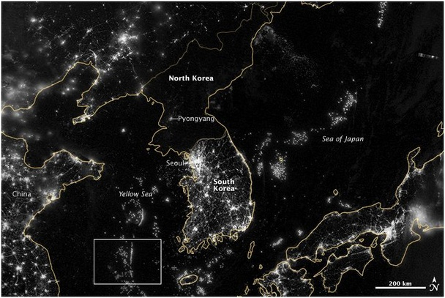
Economic Freedom in the Night

